Slide 1
SOFTWARE TESTING
Presented by: Mushtaq Ahmad Dar
M.Tech-3rd Semester
ENROLLMENT NO:2002CUKMR15

Slide 2
CONTENTS:
DEFINETION
History of software testing
TESTING TYPES
TESTING METHODS
TESTING APPROACHES
TESTING LEVELS
references

Slide 3
Software testing is the process of evaluating and verifying that a software product or application does what it is supposed to do. The benefits of testing include preventing bugs, reducing development costs and improving performance.
What is meant by software testing?

Slide 4
Software testing arrived alongside the development of software, which had its beginnings just after the second world war. Computer scientist Tom Kilburn is credited with writing the first piece of software, which debuted on June 21, 1948, at the University of Manchester in England. It performed mathematical calculations-using-machine code instructions. Debugging was the main testing method at the time and remained so for the next two decades. By the 1980s, development teams looked beyond isolating and fixing software bugs to testing applications in real-world settings. It set the stage for a broader view of testing, which encompassed a quality assurance process that was part of the software development life cycle. “In the 1990s, there was a transition from testing to a more comprehensive process called quality assurance, which covers the entire software development cycle and affects the processes of planning, design, creation and execution of test cases, support for existing test cases and test environments,” says Alexander Yaroshko in his post on the uTest developer site. “Testing had reached a qualitatively new level, which led to the further development of methodologies, the emergence of powerful tools for managing the testing process and test automation tools.”
History of software testing

Slide 5
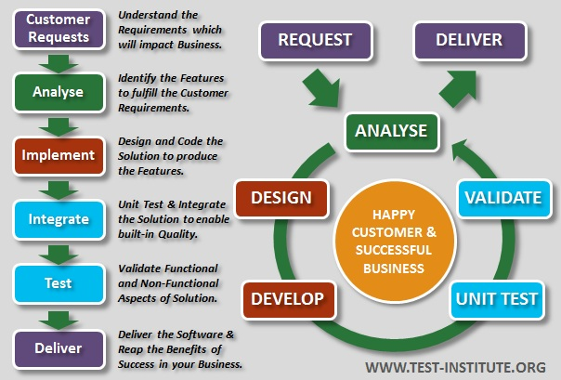

Slide 6
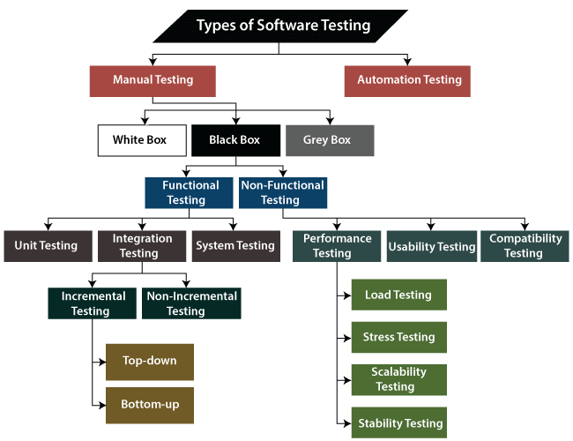

Slide 7
software testing methods
Functional Testing:
Unit testing:
TestLeft is a tool that allows advanced testers and developers to shift left with the fastest test automation tool embedded in any IDE.
Integration testing
System testing
Acceptance testing
Non-functional testing methods incorporate all test types focused on the operational aspects of a piece of software. These include:
Performance testing
Security testing
Usability testing
Compatibility testing

Slide 8
software testing methods
Functionality Testing:
This is a kind of black box testing that is specification-oriented, which is done by putting the input,
and then the output is examined whether it comes the way it is expected.
Five steps of testing are there, which involved the testing of an application for functionality. They are:
Determine the functionality which a projected software is meant to perform.
Creation of test data depending on the requirements of the application.
Check for output, depending on the data being tested along with the specifications of your application.
Scripting of scenarios by testing and then executing those test cases.
Compare the actual as well as expected output depending on the executed tests.

Slide 9
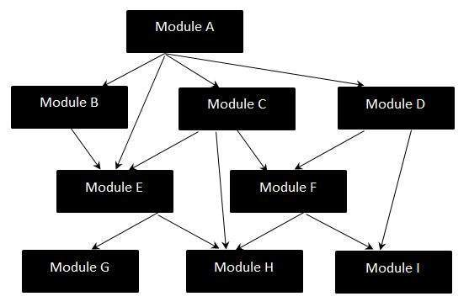
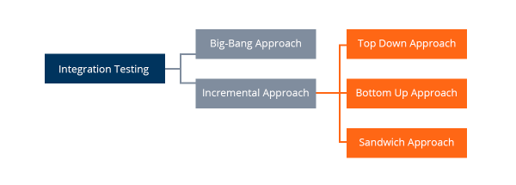
software testing approaches
Big-Bang Integration Testing – ...
Bottom-Up Integration Testing – ...
Top-Down Integration Testing – ...
Mixed Integration Testing –

Slide 10
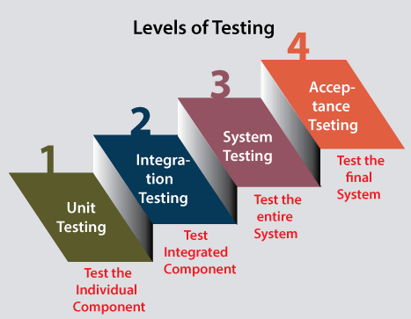
software testing Levels

Slide 11
Top 10 Automated Software Testing Tools
1. Selenium
2. TestingWhiz
3. HPE Unified Functional Testing (HP – UFT formerly QTP)
4. TestComplete
5. Ranorex
6. Sahi
7. Watir
8. Tosca Testsuite
9. Telerik TestStudio
10. Katalon Studio

Slide 12
References:
https://www.ibm.com/topics/software-testing
https://www.tutorialspoint.com/software_testing/software_testing_levels.htm
https://www.javatpoint.com/levels-of-testing
https://qatestlab.com/resources/knowledge-center/big-bang-testing/
https://www.educba.com/levels-of-software-testing/

Slide 13
Thank you

